Slide 1
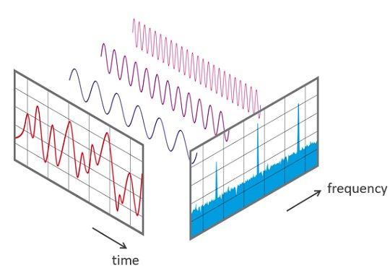
How-to Implement a DFT on a Real-Time System
Rainer Nitsche – 02/2024
Discrete Fourier Transform – DFT

Slide 2
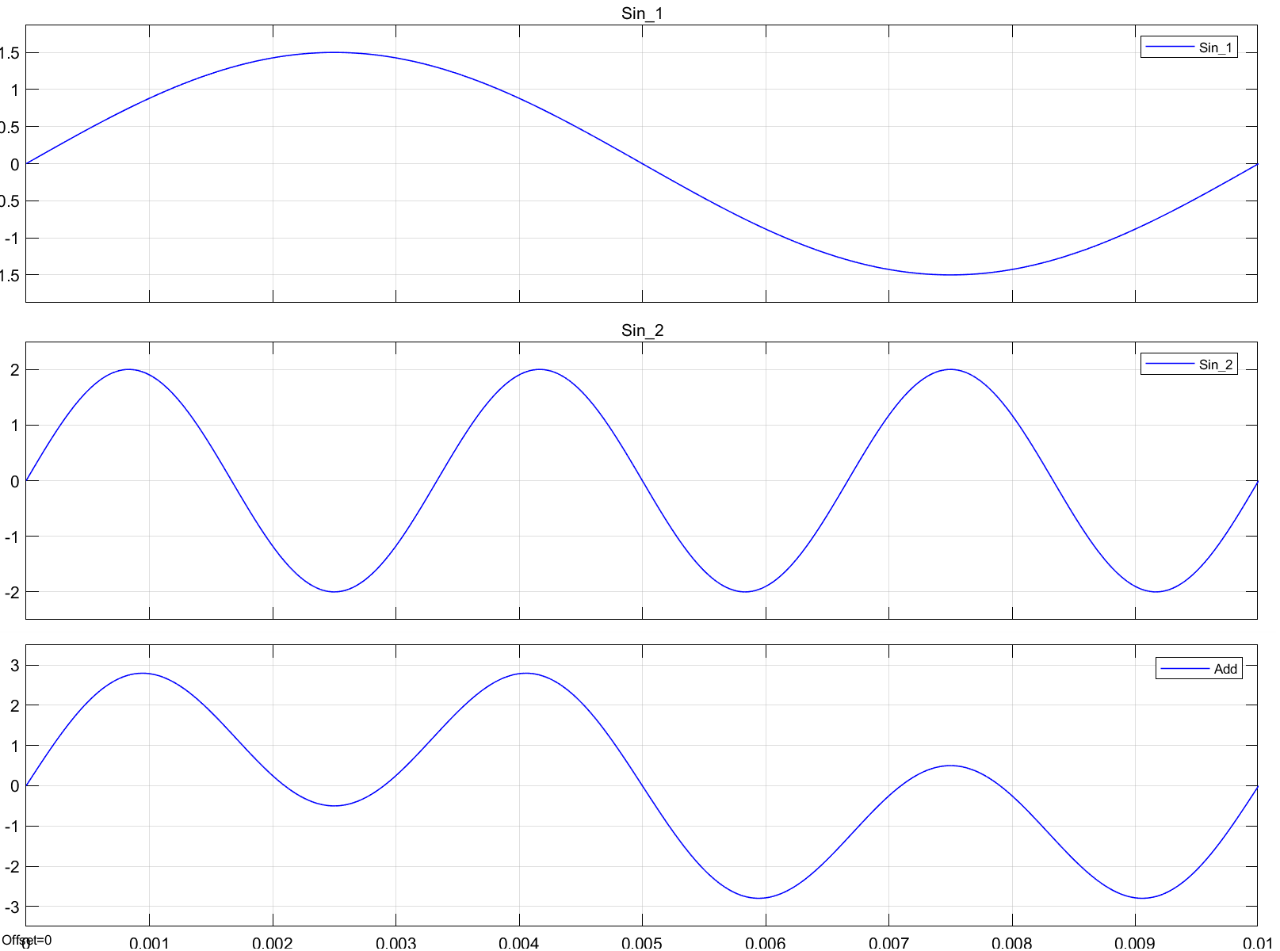
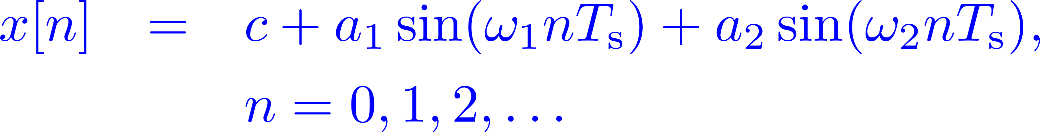
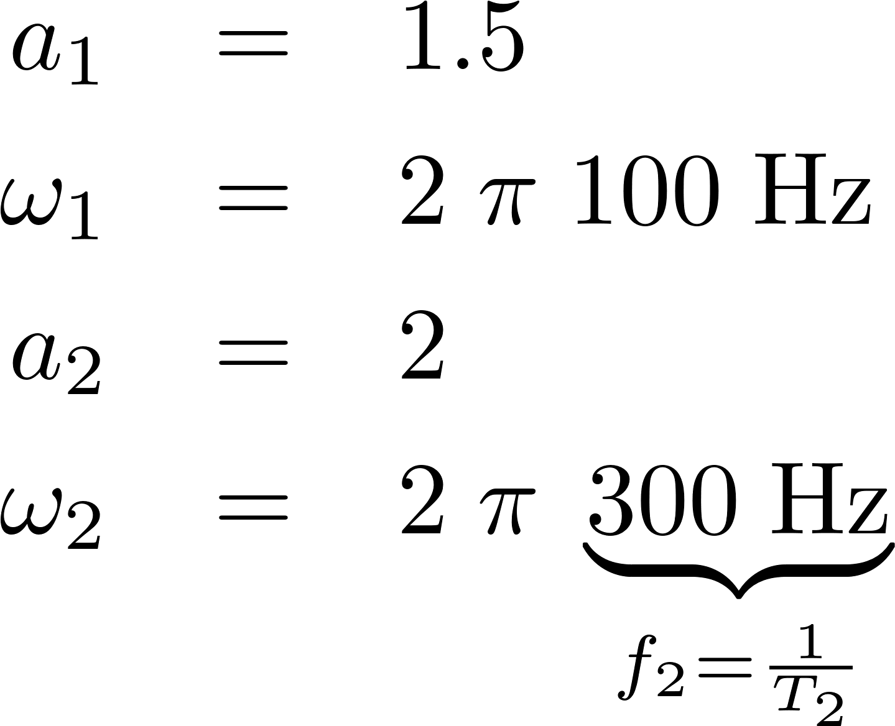
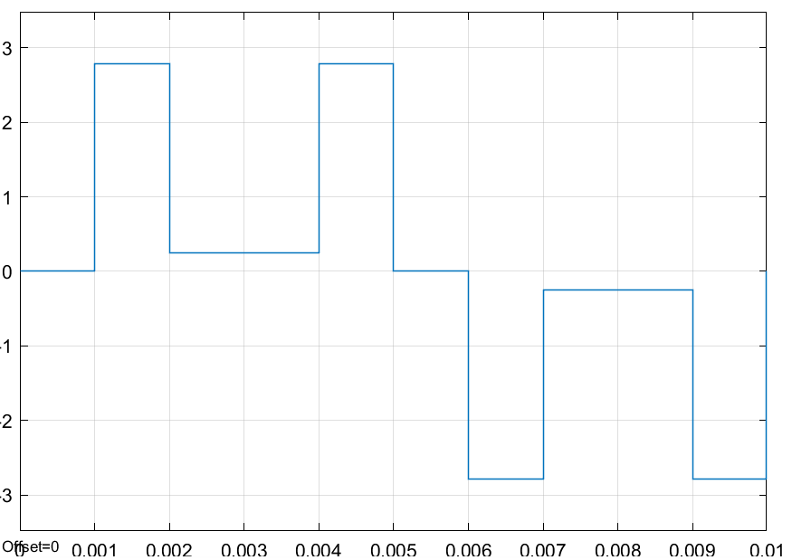
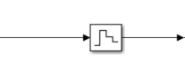
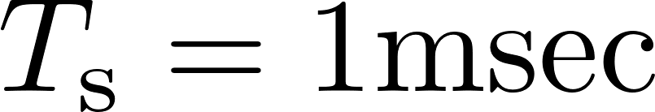

FFT in Real-Time | Objectives
Analyzing a time domain signal in the frequency domain ⇝ Fourier Transform
The fast Fourier transform (FFT) is an efficient method to compute a discrete Fourier transform (DFT)
Example
Parameters:
Time ->

Slide 3
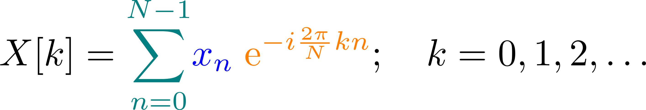



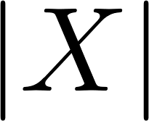
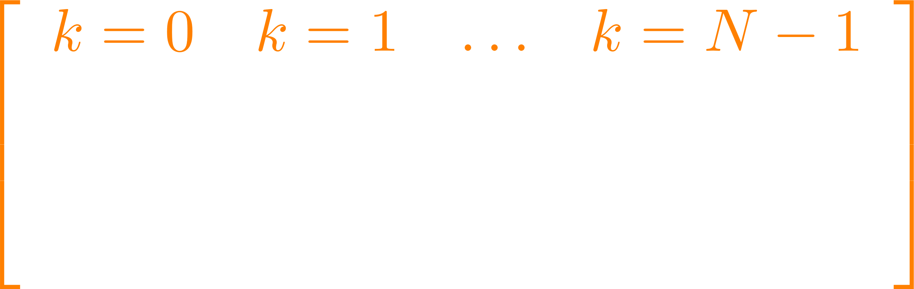
FFT in Real-Time | Discrete Fourier Transform (DFT)
https://www.youtube.com/watch?v=QmgJmh2I3Fw
We are creating sines and cosines of different frequencies
N: number of samples
Discrete-time signal
DFT: Matrix Multiplication
0 1 2 . . .
N-1
k
The fast Fourier transform (FFT) is an efficient method to compute a discrete Fourier transform (DFT)
Notes:
https://www.overleaf.com/learn/latex/Using_colors_in_LaTeX
Skalarprodukt oder inneres Produkt von xn mit der k-ten Spalte…
Für große N wird die Multiplikation sehr aufwändig -> FFT

Slide 4
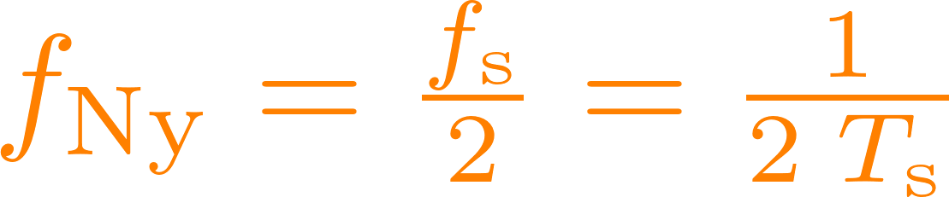
FFT in Real-Time | Practical Issues: one- / two-sided FFT
One-sided and two-sided FFT
Nyquist frequency:
positive
negative
K=0
Nyquist frequency
K=N-1
Notes:
Positive and negative Frequenzen in der FFT

Slide 5
FFT in Real-Time | Practical Issues: one- / two-sided FFT
One-sided and two-sided FFT
two-sided
negative
positive
K=0
Nyquist frequency

Slide 6
FFT in Real-Time | Practical Issues: one- / two-sided FFT
One-sided and two-sided FFT
One-sided
Nyquist frequency:
positive
Nyquist frequency is the highest frequency which can be measured / detected in the
sampled data
K=0
Nyquist frequency
Notes:
Nyquist Frequenz ist die höchste Frequenz die durch die FFT ermittelt werden kann

Slide 7




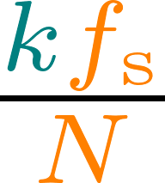
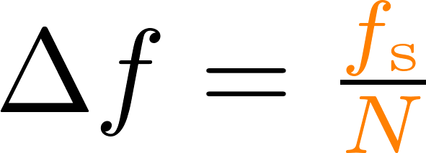
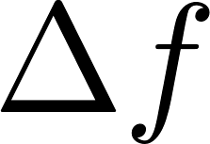
FFT in Real-Time | Practical Issues: Frequency Resolution
Length of the signal
Length of the signal
Length of the signal
Frequency = =
Length of the signal
Bin width:
Resolution
0 1 2 . . .
N-1
k

Slide 8
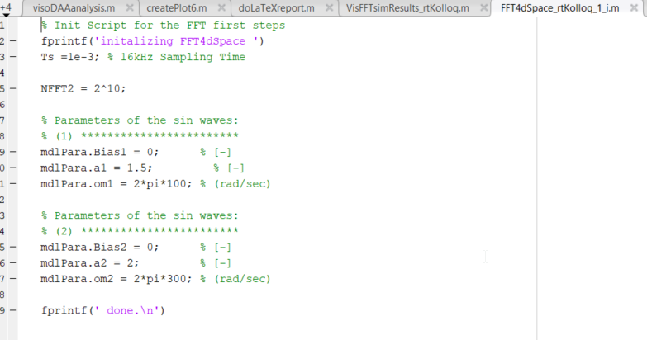
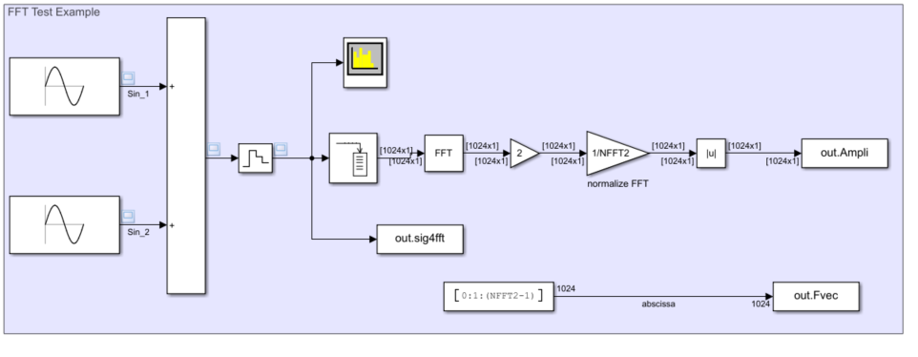
FFT in Real-Time | Simulink Example
Notes:
c:\workspace\teachingSMC\FFT\Matlab\FFT4dSpace_rtKolloq_1.slx

Slide 9
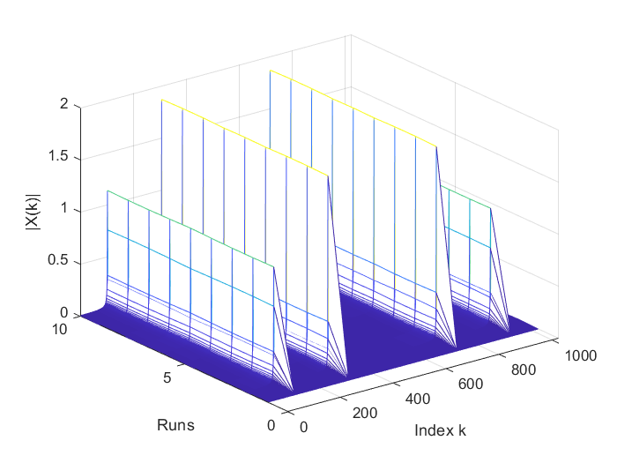
FFT in Real-Time | Simulink Example - Results
Nyquist frequency
Ts = 1msec t_sim = 10 sec
Notes:
~10 Runs: Simzeit = 10sec, 2^10 N à 1msec = 1Run takes ~1sec

Slide 10
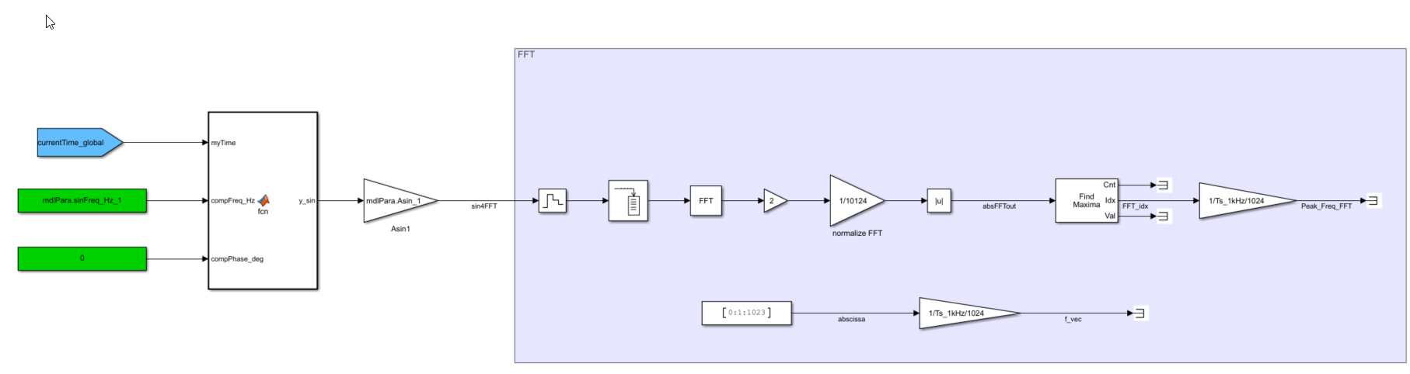
FFT in Real-Time | dSpace Example
Mdl: FFT4dSpace_1.slx
path: C:\workspace\teachingSMC\FFT\dSpace\SCALEXIO
Notes:
C:\workspace\teachingSMC\FFT\dSpace\SCALEXIO

Slide 11
FFT in Real-Time
Link to video: Steve Brunton / Matlab
Simulink Implementation
Plotting resutls from simulation and data capture…
How to chose:
Sample Time Ts
Number of samples for FFT : 2^N
Bin Width (Frequenzauflösung)
Nyquist Frequency
Leackage effect

Slide 13
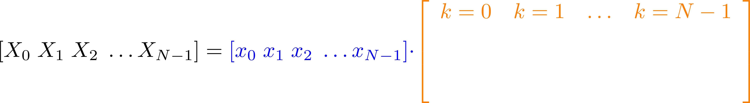
FFT in Real-Time | Discrete Fourier Transform (DFT)
We are creating sines and cosines of different frequencies
Discrete-time signal
https://www.youtube.com/watch?v=QmgJmh2I3Fw
Notes:
https://www.overleaf.com/learn/latex/Using_colors_in_LaTeX
Skalarprodukt oder inneres Produkt von xn mit der k-ten Spalte…

